Slide 1

Predict COVID-19 Hospital Patient Length of Stay using Random Forest
Khatti, Abhishek
Notes:
Currently working as a Principal SAP Software Engineer and Business Analyst at IGT Corporation in Providence RI
Total professional work experience of 12+ years in the industry.
Currently pursuing my Masters degree in Data Analytics from WGU.

Slide 2
Background, Statement of Problem & Hypothesis

Slide 3

Problem At Hand – COVID-19 Hospitalizations
Strain on Hospitals
Shortage of Resources
Demand Planning & Resource Allocations
Reassignments of Resources
Dilemma for hospital management
Notes:
COVID-19 pandemic - extraordinary strain on health care systems,
rapidly increasing demand on hospitals and intensive care units (ICUs) worldwide.
Determining the needs for healthcare resources (beds, staff, equipment) has become a key priority for many countries.
2. Biggest Dilemma for hospital management - Should we share resources with other struggling hospitals or maintain stocks of PPE, staff and medical supplies?
3. Projecting future demand requires estimates of how long patients with COVID-19 need different levels of hospital care.

Slide 4



What’s in the Box?
Understanding the Data to be studied
What’s the source?
Is the data Public or Proprietary?
What is the target of Study?
What defines the target?
Notes:
Before explaining the problem & hypothesis, first let’s see understand what’s in our black box, that is our data for study
Source – Kaggle, uploaded by user named Mobius
Data is marked as CC-0 by “Creative Commons” org which grants copyright permissions. And CC:0 is marked as “No Copyright” or Publicly available data
The Length of Stay for each case of COVID-19 patient. It is categorical – which means it has a finite number of discrete classes. Our target name is – Stay_Days and it has 11 distinct categories
Means what properties of data makes a specific outcome of a target. In other words, what independent features causes a specific outcome within the target. – There are 17 variables that define the outcome of target

Slide 5
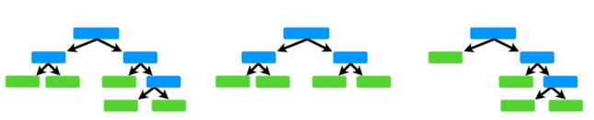
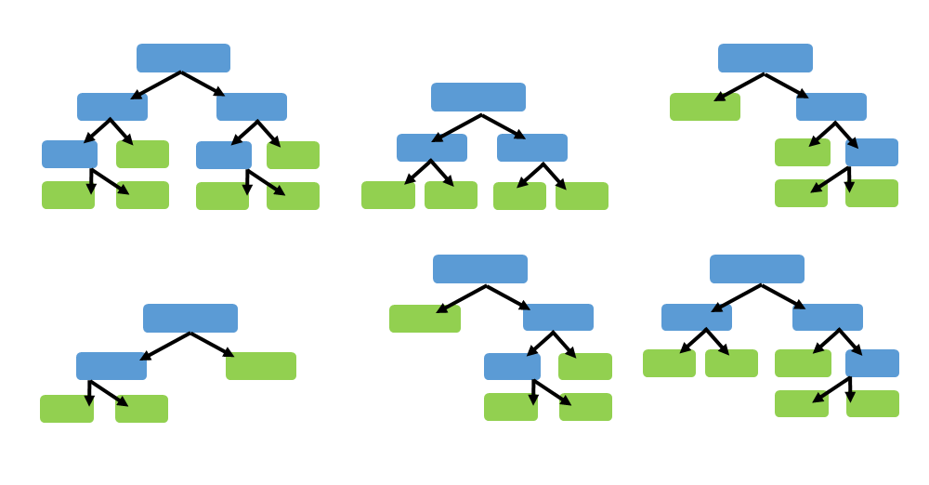
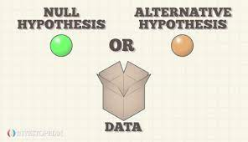
What to Study & What to Test?
Problem in Question
Using a Multi-Class Random Forest Classifier, can we predict how long a patient would probably stay for treatment?
Hypothesis
Null Hypothesis – The Random Forest classification model cannot meaningfully distinguish between that target classes
Alternative Hypothesis – The Random Forest classification model can distinguish between the target classes
Notes:
What is a Random Forest – Collection of Decision Trees, where each node in a tree shows a decision to be made, and an end node shows the final outcome of a decision path. Also known as a “Bagging Classifier”
Each of the trees within a Random Forest are generated with some form of randomness, such as choice of stating node, how deep the tree goes, how many features are used in that tree, etc.
Generally, its robust against common data issues, since it uses multiple randomly generated trees and uses a “voting” system to generate the predictions

Slide 6
Summary of Analysis

Slide 7
How does the raw data look?
Field | Type
case_id | Unique Case ID
Hospital | Categorical
Hospital_type | Categorical
Hospital_city | Categorical
Hospital_region | Categorical
Available_Extra_Rooms_in_Hospital | Continuous
Department | Categorical
Ward_Type | Categorical
Ward_Facility | Categorical
Bed_Grade | Categorical
patientid | Categorical
City_Code_Patient | Categorical
Type of Admission | Categorical
Illness_Severity | Categorical
Patient_Visitors | Continuous
Age | Categorical
Admission_Deposit | Continuous
Stay_Days | Categorical
A single CSV file
1 Target Variable – Stay_Days
17 Independent Features – Continuous & Categorical
318,438 number of rows
Missing data in 4,645 rows
Notes:
Before getting into nitty-gritty details, lets understand the raw data first

Slide 8
Hardware & Software
Local Machine – Dell Precision Laptop
Azure ML Node “Compute”
56GB RAM
6 cores CPU
1 GPU
380GB disk space
Python
Python Libraries
Azure ML Portal
Python 3
Python Azure ML 3.6
Pandas
Numpy
Scikit-Learn
D-Tale
Seaborn
Matplotlib
imblearn
Statsmodels
Azure Python Notebooks
Jupyter Editor
Notes:
The workstation and the technical environment where analysis and machine learning models are trained is important. Lack of resources can impediment in generating useful models.

Slide 9
Approach to Study
Set Hypothesis of Study
Finalize Evaluation Criteria
Data Collection
Feature Analysis
Data Extraction
Data Preparation
Data Activities
Feature Engineering
Tests of Correlations
Test of Association
Prepare for Honest Assessment of Models
Model Training & Hypothesis Testing
Important Features
Tuning the Model
Balancing Imbalanced Target
Bottomline Performance Assessment of Models
Limitations of Techniques & Tools
Summary of Proposed Actions
Expected Benefits
** Acknowledgements & References

Slide 10
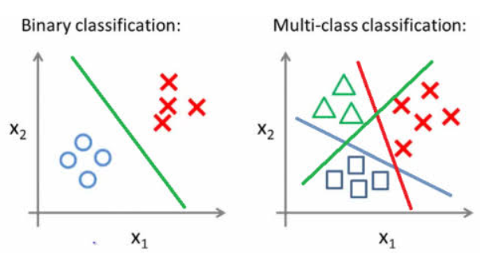
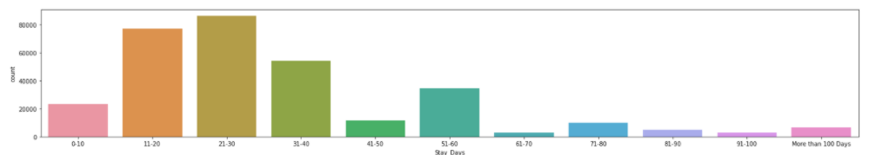
Evaluation Criteria – Challenge
Binary vs Multi-Class Targets
Number of Target Classes
Imbalanced Problem
This is the exact problem we are in!
Complicated, is there no hope?
Notes:
Binary Classification – Can the classification model distinguish between 2 Target classes – e.g. Is the customer going to churn – Yes (1) or No (0); Is this email spam – Yes (1) or No (0)
Multi-Class Classification – When a model is trying to classify more than 2 Target classes – e.g. Is this an Apple (0), Orange (1) or a Grape (2); Is this patient going to stay between 0-10 days (0), 11-20 days (1), 21-30 days (2) or More than 30 Days (4)?
Now consider the 1st image – Binary Classification – If you have a draw a line (decision boundary) to separate Xs and Os drawing a line is comparatively easier in this case.
Now consider the 2nd image – Multi-class classification – If you have to draw a decision boundary between each pair of shape Xs, Squares, and Os, the tasks gets a bit challenging than Binary.
Now image if there are 11 Target classes, and we have to find this decision boundary between each pair of class in this graph, the task just got a whole lot more complicated. To add to complexity – what if some of the points of two of the classes are so close to each other or are crossing each other territories, how to draw this decision boundary then? – Also, how to accurately these decision boundaries would separate new points?
Add another complexity to it, what if the number of points each class is not equal – one class has 50% of overall points and other 10 make up the remaining one. Wouldn’t the 1st class be all over the place?
So, if it is so complicated to draw the boundaries, can we not accurately predict the classes?

Slide 11

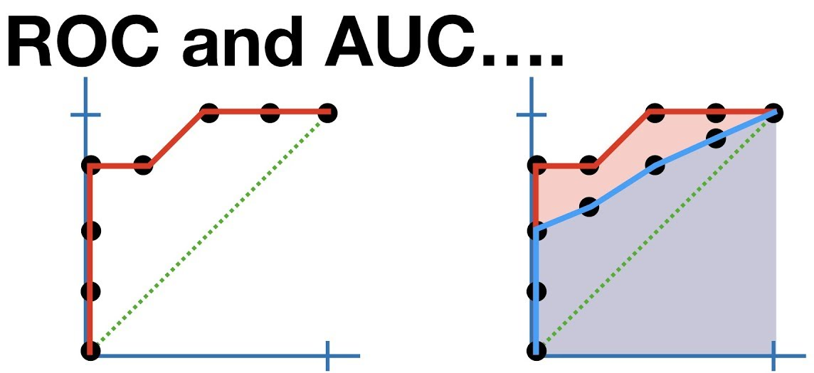
Evaluation Criteria – Solution
Predict the Probabilities rather than class labels directly
Accuracy Metric is not always good.
ROC-AUC to the rescue!
Repeated Stratified K Fold Cross-Validations
Notes:
Yes, we can! – We just reach there differently.
Generally, accuracy is the best metric for classification problems. But that is not always the best option when dealing with multi-class and imbalanced problems.
Instead of directly predicting what class to place the new record in, we predict what is probability that it belongs to a class. The class with the highest probability wins, and we predict that it probably (quotes) belongs to this class.
The performance metric used to measure that is called – ROC (Receiver Operating Characteristic) curve and we measure AUC (Area under that curve). The larger the area under the curve, the better the model distinguishes between the target classes.
When evaluating models, to ensure the validation scores are not a result of chance, the data set is split into “K” number of folds and all folds except one is used to train the model. Once the model is trained on this subset, the last fold is used to validate the model performance. This is repeated the specified n-number of times, so we get a good understanding of the model performance.

Slide 12
Outline of Findings

Slide 13
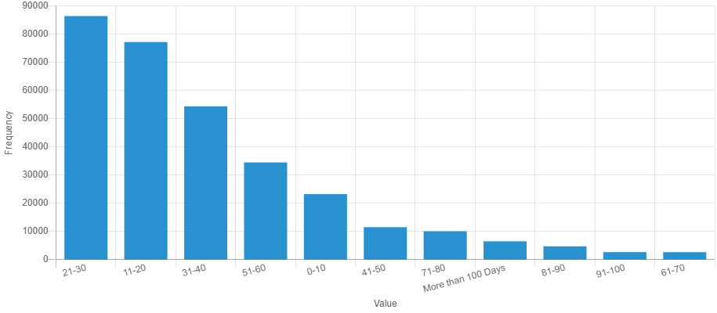
Feature Analysis – Target
Target Feature
Stay_Days
Categorical
11 Classes
27.5% of Patients stay between 21-30 Days
Only 0.85% Patients stay between 61-70 days
Uneven distribution among classes – Imbalanced

Slide 14
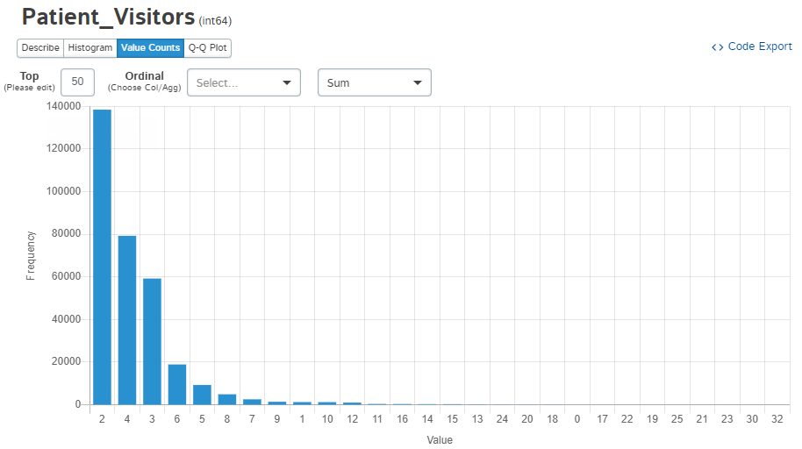
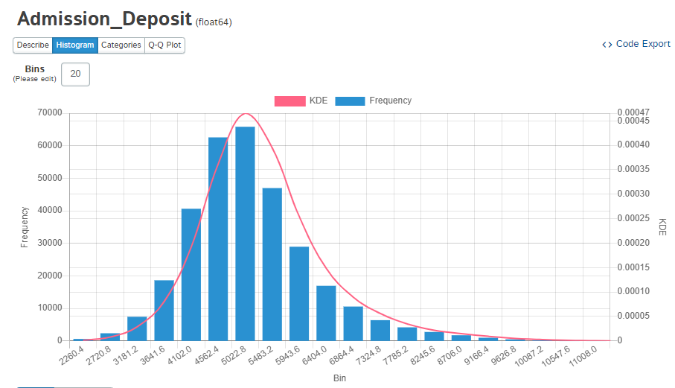
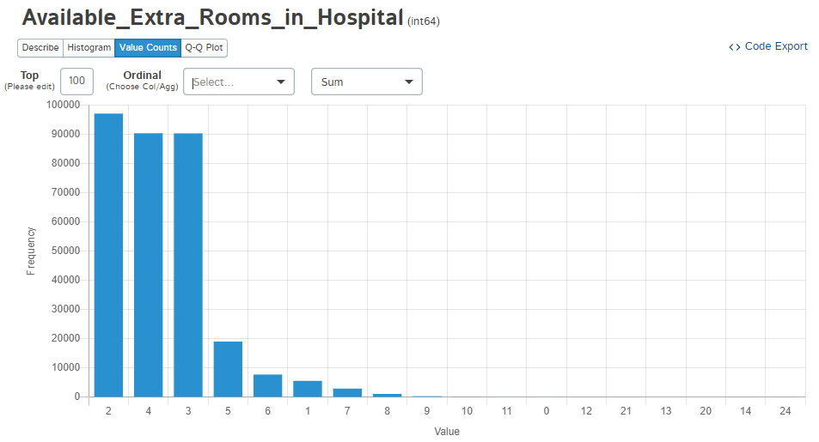
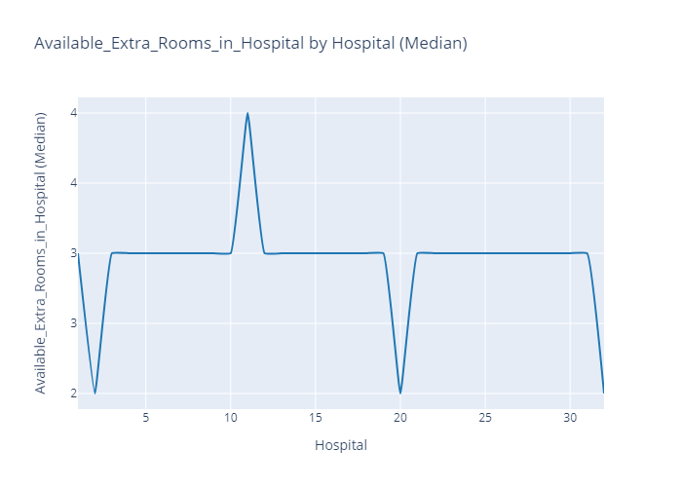
Feature Analysis – Independent Continuous
Patient Visitors
43.5% patients has 2 visitors
1.12% of patients had 10 visitors or higher
Admission Deposit
Median Deposit amount at admission – $4,742
Max Amount – $11,008
Number of Extra Rooms Available
At a given time, most hospitals had 2 to 4 rooms available.
Hospital 11 has a highest median availability at 4 rooms.

Slide 15
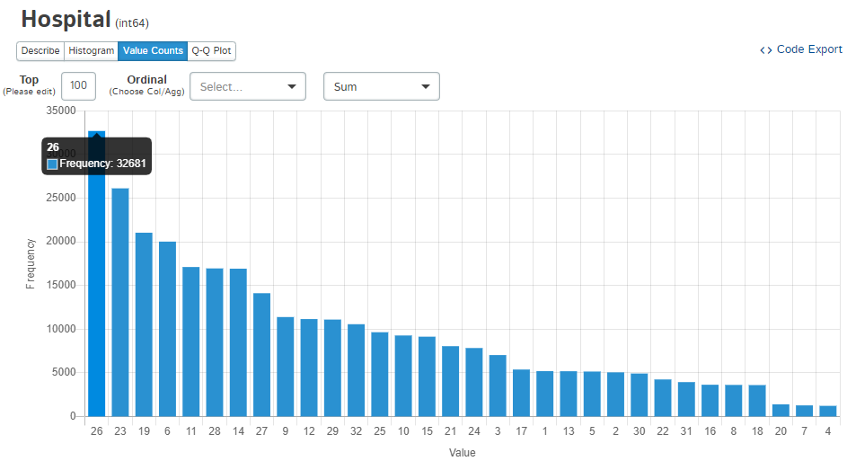
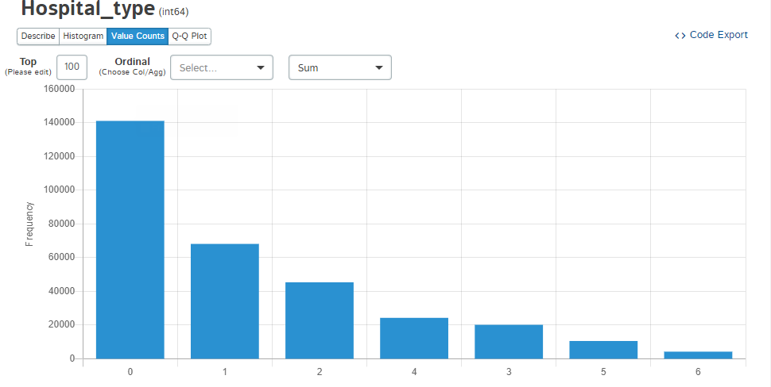
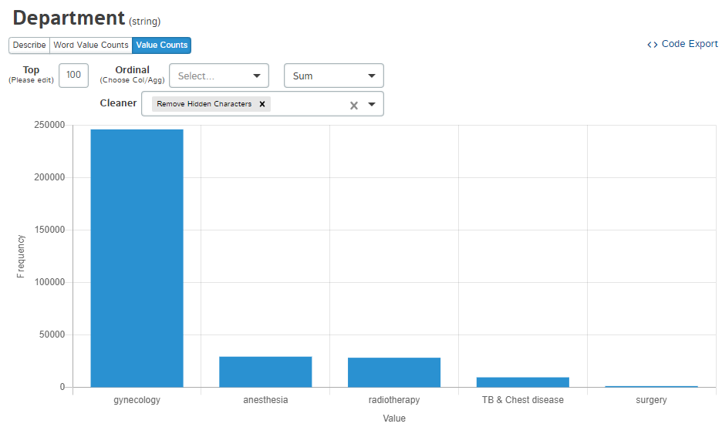
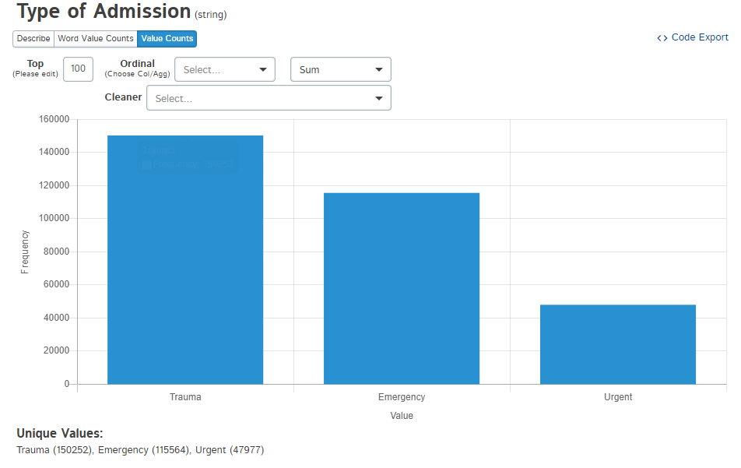
Feature Analysis – Independent Categorical
Hospital
Hospitals 26, 23 and 19 has highest number of patients
Hospital Type
Type 0 has the greatest number of patients
Department
Gynecology department has the highest percentage of admissions.
Need additional patient details for further analysis
Type of Admission
Trauma and Emergency centers has highest proportion of admissions

Slide 16
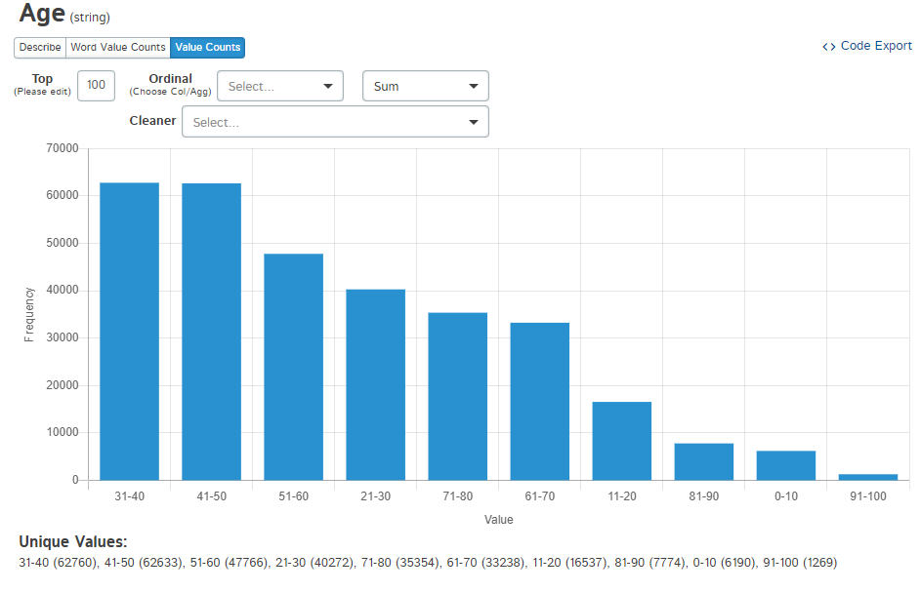
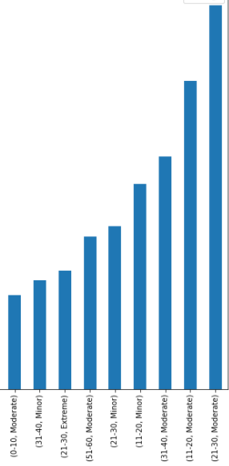
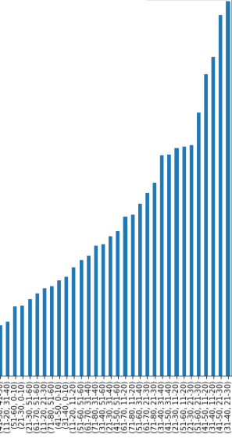
Feature Analysis – Independent Categorical
Illness Severity
Most patient report Moderate to Minor symptoms
Patients with Moderate to Minor symptoms likely to stay between 11-30 days
Age
Patients between 31-60 age make up most of the hospitalization cases among all age groups
Patients from age group 31-40 staying between 21-30 days make up the highest percentage of admissions.

Slide 17
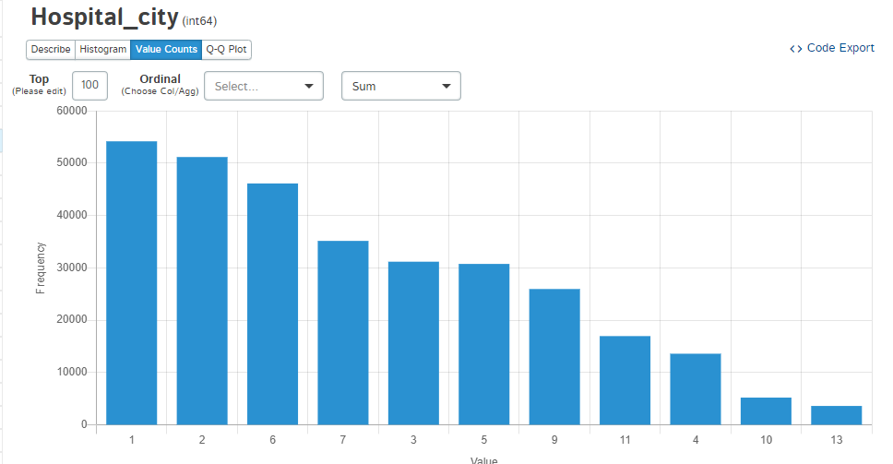
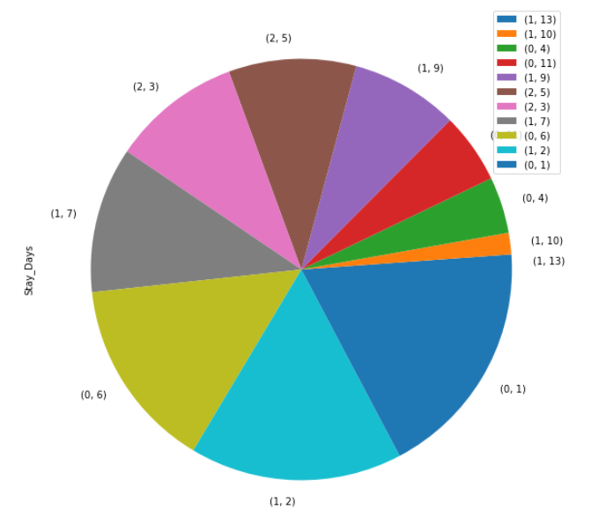
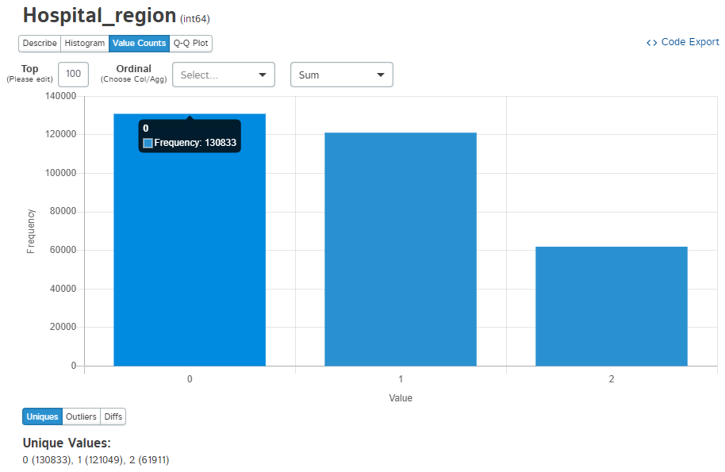
Feature Analysis – Independent Categorical
Hospital Region
Highest number of hospitalizations in Region 0 followed by 1.
Hospital City
City 1, 2 & 6 have highest number of patients
City 1 & 6 – part of Regin 0
City 2 – part of Region 1
Crucial to check relationship between region and length of stay

Slide 18
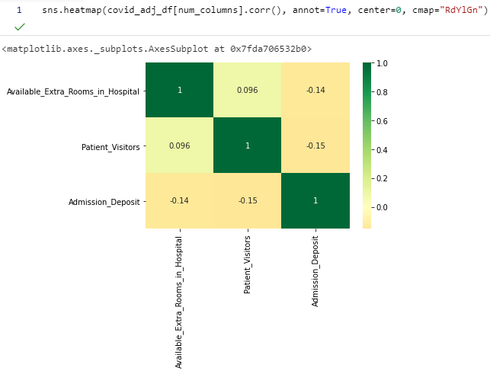
Tests of Correlations & Association
Multicollinearity – adds bias and chance of overfitting the training models – leads to false results
Currently, very weak correlations exist between continuous variables
Based on Multinomial Logit Association tests, region is statistically with length of stay at all levels
Tukey’s Post-Hoc comparisons show that region 0 & 1 and 0 & 2 are significantly different than each other, but 1 & 2 not significantly different.
High level regional resource management plan can be shared between regions 1 & 2, but region 0 will require tailored plan

Slide 19
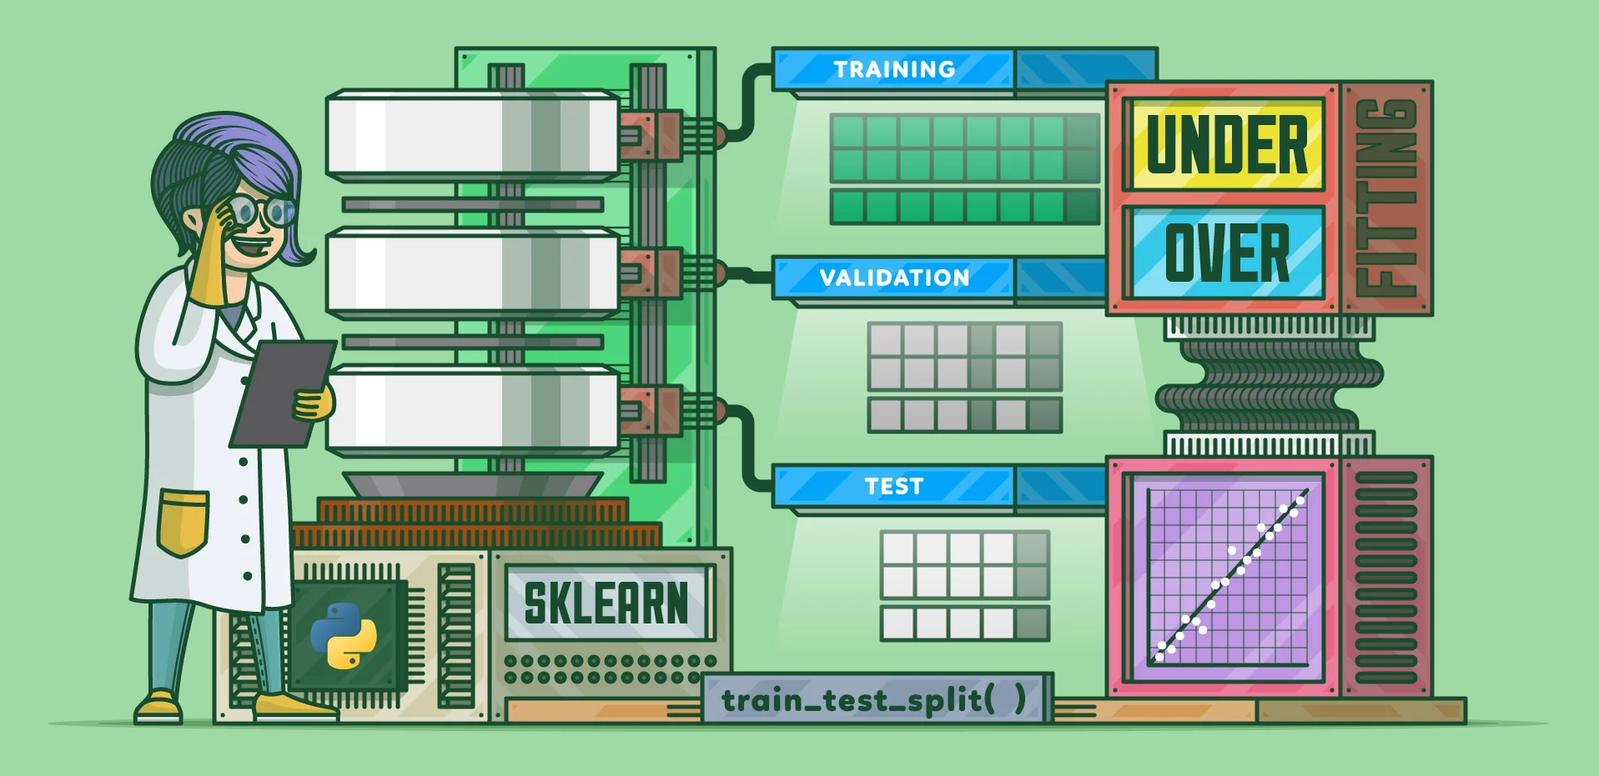
Honest Assessment
Easy to use the entire data for model training, but that does not give assessment of model on new data.
Split into two sub-sets – Training & Validation
Training – Used for Model Training & Hyper-Parameter Optimizations
Validation – Used to assess the trained model for performance
Split is 80-20 – 80% Training, 20% Validation

Slide 20
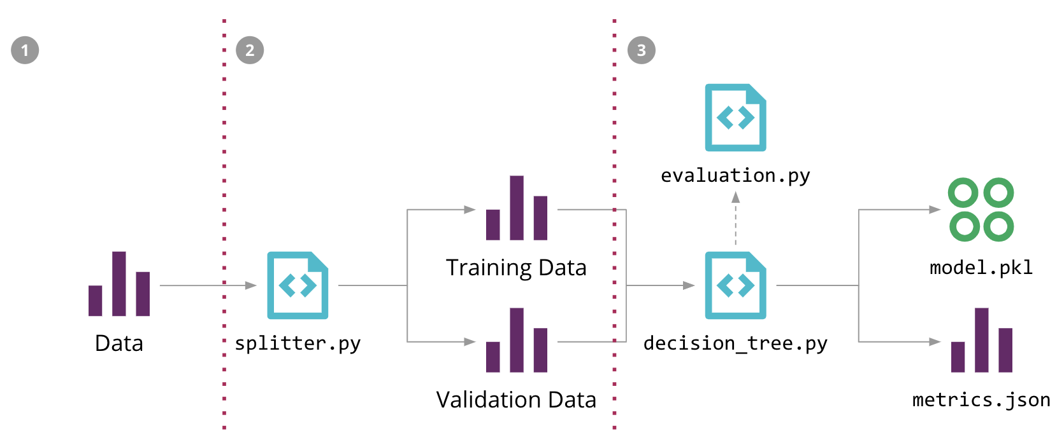
Model Training
Two Types of Models are trained
Dummy Classifier Model – predicts only random or a constant class
Multi-Class Random Forest Classifier model – uses ensemble of Decision Trees to make predictions
Dummy Classifier
Repeated Stratified K Fold Cross-Validation score on entire data – 0.5 or 50%
Does not distinguish between target classes
Base Multi-Class Random Forest Classifier
Base – Use only default values
Repeated Stratified K Fold Cross-Validation score on entire data – 0.7708 or 77.08%
Increase of 0.2708 AUC points or 54.16% compared to Dummy Classifier model

Slide 21

Verdict on Hypothesis Test?
Null Hypothesis Check
Dummy Classifier Model – Average AUC score 0.5 or 50%
Multi-Class Random Forest Classifier model – Average AUC score 0.7708 or 77.08%
The Random Forest model clearly performs better on the data set than a random or a constant prediction.
Decision
The Null Hypothesis can be rejected in favor of alternative hypothesis
The Multi-class Random Forest can be used for classifying the patient length of stay at the time of admission

Slide 22
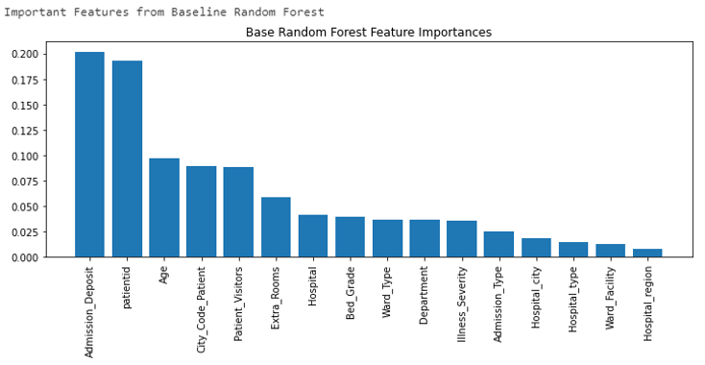
Important Features
Top 3 most important features
Admission_Deposit
Patientid
Age

Slide 23
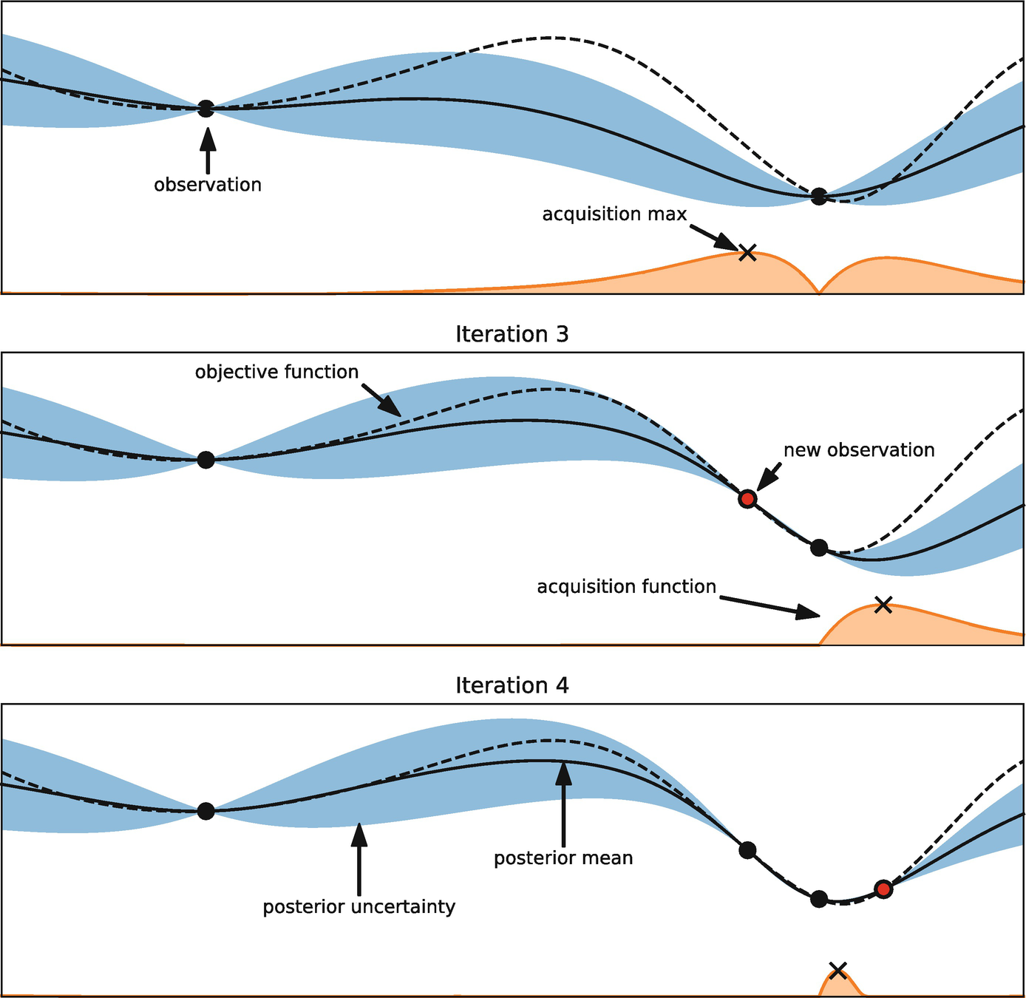
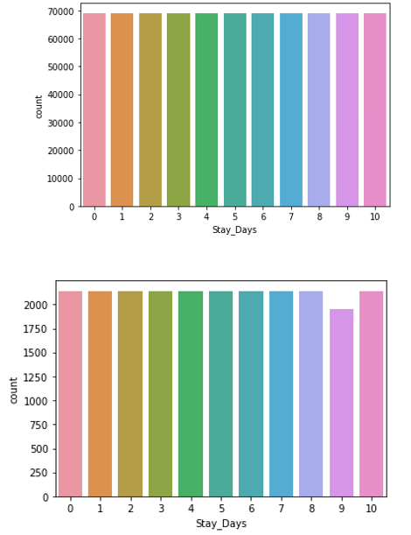
Hyper-Pararmeter Tuning & Balancing Imbalanced Target Classes
Model Tuning Under-Sampling
Over-Sampling
Hyper-Parameters for Random Forest Classifier – the devil in the details!
Important Hyper-Parameters
Maximum Number of Trees
Maximum Depth of Trees
Criterion to use for Splits
How each target class should be weighted
Balancing Imbalanced Classes
How to find best combination of these Parameters?
Random Search Cross-Validations
Grid Search Cross-Validations
Under-Sample Majority Target Classes
Over-Sample Minority Target Classes
For both options, use the best parameters from Grid Search CV
Notes:
Hyper-Parameters – imagine this as dial which can be set a variety of different settings – each setting combination within the parameter changes the performance of the model
E.g. How many number Decision Trees to build in the forest?
What’s the maximum depth each Decision tree should reach?
What scoring criterion to use to split the tree node into branches … and so on
Here number of trees, depth of tree, Bootstrap sampling where data to be used for training is sampled with replacement and if “Out-of-Bag” scores are to be used for validations, are some of the hyper-parameters used
Approach –
First perform 100 iterations and 3 repetitions using Random Search. – Best model and parameters for the given training data.
Then use the best parameters from this output to fine tune using systematic Grid Search
The final resulting model and parameters are used to train the further models
Balancing Imbalanced Classes – Although Random Forest algorithm is generally robust for Imbalanced Target data set – good practice to check the impact of imbalances in the data

Slide 24

Bringing it all Together – Comparing all Model Performances
Avg. Repeated Stratified K Fold Cross-Validation Scores – 5 Splits, 10 Repeats!
Dummy Classifier
50%
Base Random Forest
75.18%
Random Searched
RF Model
78.04%
Grid Searched
RF Model
77.89%
Under-Sampled
RF Model
77.91%
Best Multi-Class Random Forest Model found!!
Over-Sampled
RF Model
77.88%
Notes:
The best estimator model from RandomizedSearchCV results in the best Average AUC score of 78.04%, which is significantly higher than the dummy baseline model at 50%

Slide 25
Limitations

Slide 26

Limitations
Data Limitations
Only Patient Stay Details
No Patient Medical History
Technical Limitations
Resource intensive Scikit-Learn library
Potential compromise during Hyper-Parameter tuning
Random Forest is algorithm good, but probably not the best
Notes:
1. The prior health history could greatly influence how the patient would respond to the treatment, which could influence how long the patient would be staying at the hospital.
2. in-memory and CPU usage of Python’s Scikit-Learn package.
memory requirements increase exponentially as the depth of the decision tree
3. for the given data set might not be the most optimal predictive model
4. another exercise to fit random forest model using different Python packages which would utilize GPU, increased memory in the environment and CPU resources, and using a different architecture like Spark could be warranted

Slide 27
What Next?

Slide 28
Proposed Actions for Future
Further Studies can go in few directions –
Try Different Technical Approach
Extreme Gradient Boost (XGBoost) Classification
Different Architectures like Spark – optimal for large data sets
Get More Patient Details
Patient Medical History along with stay details
Deployment options through APIs for integration with other Enterprise Applications
Artificial Neural Network Classification
Notes:
1. The prior health history could greatly influence how the patient would respond to the treatment, which could influence how long the patient would be staying at the hospital.
2. in-memory and CPU usage of Python’s Scikit-Learn package.
memory requirements increase exponentially as the depth of the decision tree
3. for the given data set might not be the most optimal predictive model
4. another exercise to fit random forest model using different Python packages which would utilize GPU, increased memory in the environment and CPU resources, and using a different architecture like Spark could be warranted

Slide 29
What’s the Benefit of this Study?

Slide 30

Expected Benefits of Study
Alternative Hypothesis Accepted – Classification Machine Learning Models can predict meaningful probabilities for Target Classes
Knowing probable length of stay of Patient at the time of admission – optimized resource allocations in hospitals
Tailored high-level Management Plans for regions getting impacted the most
Opens pathway for future studies and investment in exploring advanced classification algorithms and enriching training data – Better confidence in Resource Management Plan execution
Possible cost savings
Better management of personnel and resources
Shared plans for regions not statistically different than other – results in quicker rollouts of new or changed plans
Notes:
4 Major Benefits
1. Confirmation that a Multi-Class Classification model can be created for this data set
2. The potential length of stay duration can be predicted along with its maximum probability
3. Knowing which regions are expected to have highest resource demand helps in rolling specific resource management plans for those regions. For regions that are not significantly different – some management plans can be shared
4. Lastly, this opens pathways to explore options to further streamline and optimize predictions of patient length of stay

Slide 31
Acknowledgements
The raw data set was obtained from the Kaggle website (Mobius, 2020).
The document templates were provided by the Writing Center team from Student Success Centers, with additional details referred to APA style formatting from WGU Knowledge Center (WGU Knowledge Center, solene, "APA Document Formatting", 2018).
All the sources listed under the “References” section of this report were used to refer to details and instructions to complete this analysis and report.
Finally, sincere gratitude to “William Sewell” and “Kelly Smith” for their exceptional guidance, support, and encouragement throughout this course.

Slide 32
References
Data Analytics Graduate Capstone. (2020). TCM2. https://tasks.wgu.edu/student/001101075/course/20280006/task/2649/overview.
Mobius. (2020, November 5). COVID-19 Hospitals Treatment Plan. https://www.kaggle.com/arashnic/covid19-hospital-treatment.
Band, A. (2020, May 14). Multi-class classification - One-vs-all &amp; One-vs-One. https://towardsdatascience.com/multi-class-classification-one-vs-all-one-vs-one-94daed32a87b.
Brownlee, J. (2020, January 14). Tour of Evaluation Metrics for Imbalanced Classification. Machine Learning Mastery. https://machinelearningmastery.com/tour-of-evaluation-metrics-for-imbalanced-classification/
Brownlee, J. (2020, August 2). A Gentle Introduction to k-fold Cross-Validation. Machine Learning Mastery. https://machinelearningmastery.com/k-fold-cross-validation/.
Sankara. (2018, June 21). How handling of missing values affects Model Accuracy. https://medium.com/@SankaraJ/how-we-handle-missing-values-affects-the-accuracy-of-machine-learning-models-c120310141b5.
Ozen, B. (2017, March 6). Multi-class Classification on Imbalanced Data using Random Forest Algorithm in Spark. https://www.linkedin.com/pulse/multi-class-classification-imbalanced-data-using-random-burak-ozen/.
Malik, U. (2018). Random Forest Algorithm with Python and Scikit-Learn. https://stackabuse.com/random-forest-algorithm-with-python-and-scikit-learn/.
BurtchWorks. (2020, December 17). 2020 SAS, R, or Python Survey Results: Which Tool do Data Scientists & Analytics Pros Prefer? https://www.burtchworks.com/2020/12/16/2020-sas-r-or-python-survey-results-which-tool-do-data-scientists-analytics-pros-prefer/.
Plonski, P. (2020, June 24). How to reduce memory used by Random Forest from Scikit-Learn in Python? MLJAR Automated Machine Learning. https://mljar.com/blog/random-forest-memory/
statsmodels User Guide. (2021, February 2). MNLogit. https://www.statsmodels.org/stable/generated/statsmodels.discrete.discrete_model.MNLogit.html
pingoouin User Guide. pingouin.pairwise_tukey. pingouin.pairwise_tukey - pingouin 0.3.10 documentation. https://pingouin-stats.org/generated/pingouin.pairwise_tukey.html#pingouin.pairwise_tukey.
scikit-learn User Guide. scikit-learn 0.24.1. sklearn.model_selection.train_test_split. https://scikit-learn.org/stable/modules/generated/sklearn.model_selection.train_test_split.html.
Narkhede, S. (2021, January 14). Understanding AUC - ROC Curve. Medium. https://towardsdatascience.com/understanding-auc-roc-curve-68b2303cc9c5.
Naik, K. (2020, July 23). All Hyperparameter Tuning Techniques. https://www.youtube.com/watch?v=355u2bDqB7c&amp;ab_channel=KrishNaik. ------- (Naik, 2020)
Hotulainen , R. (2019). Multiple-Comparison Procedures. https://www.mv.helsinki.fi/home/hotulain

